Slide 1
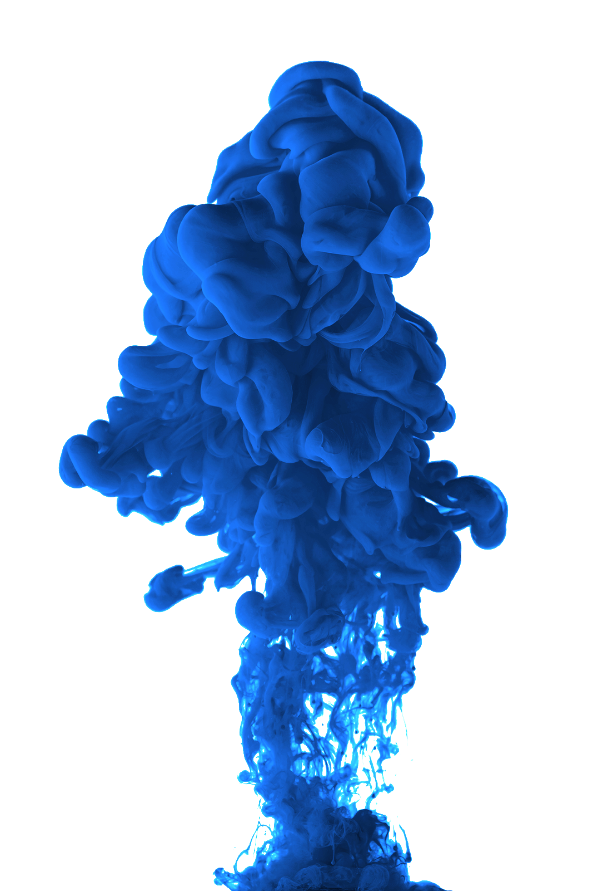

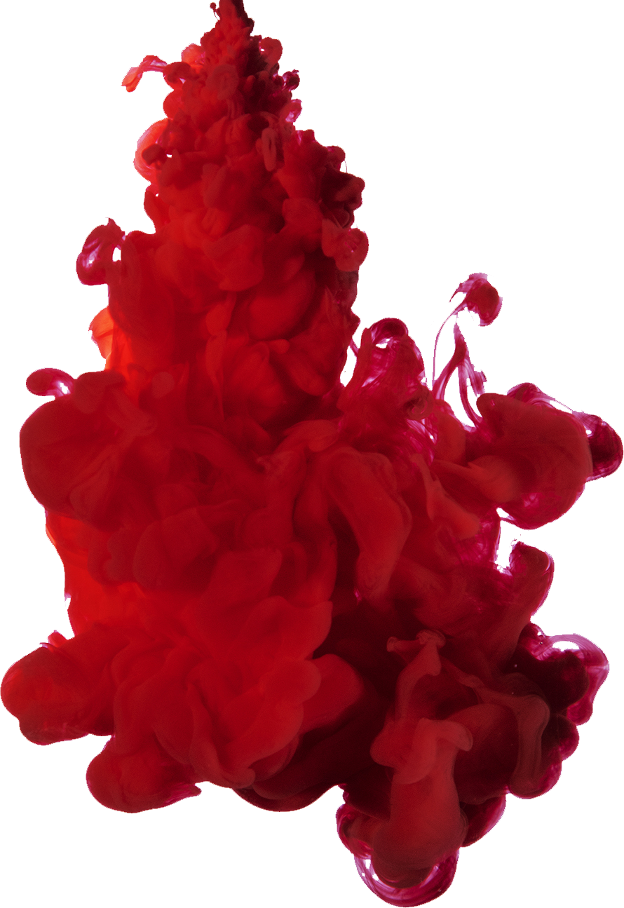
R/Place Bot Analysis Extended

Slide 2
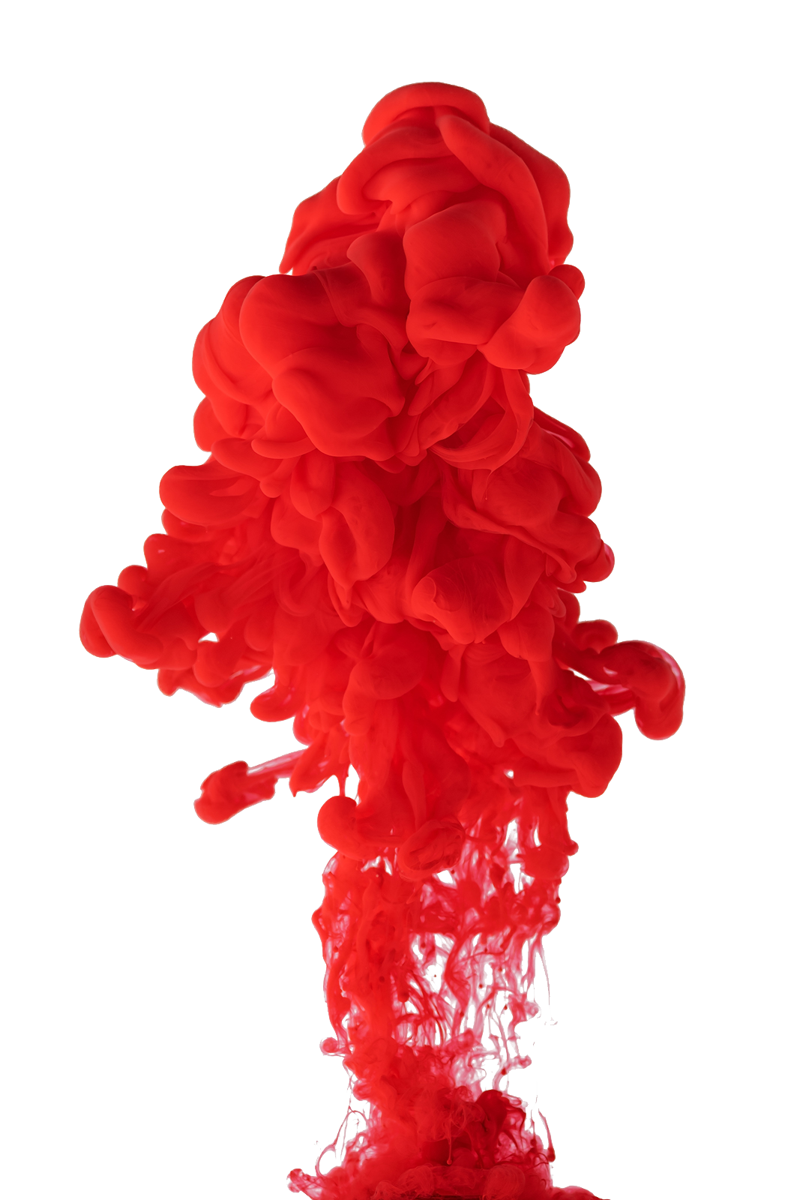
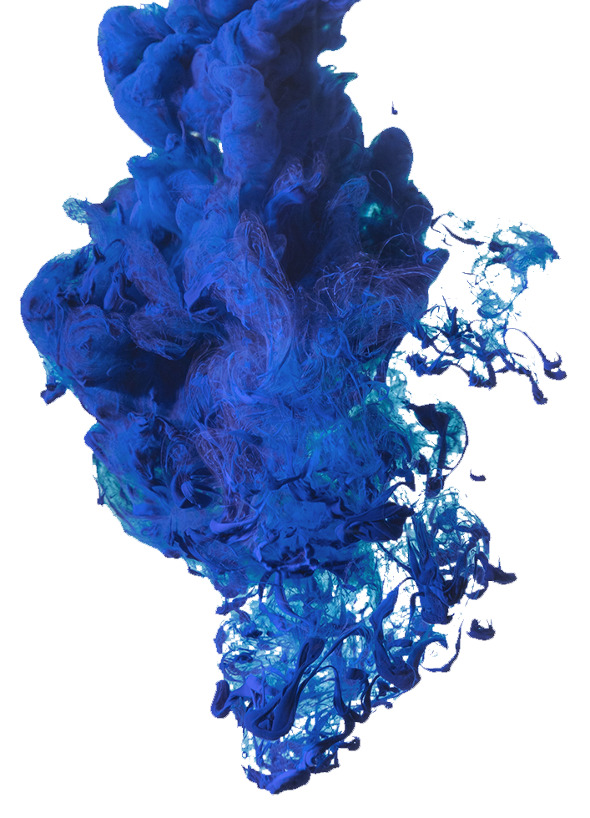
Previous Analysis
Uploaded 53 csv files to S3 for analysis
Visualized Data based on frequency inside 5 minutes
S3
Redshift
Tableau
What’s Next?
Migrated Data to merge files and allow for visualizations
Picture of Bot Activity

Slide 3
Filtering to Detect Bots
Phase 1
1 | Specific Pixel has color at certain timestamp
2 | Pixel color changes to a different color
3 | Pixel Color changes back to original color within 20 milliseconds
4 | Return observations based on specifications above
Phase 2
5 | Focus further on repeating color inputs in specific pixels
6 | Same colors repeating in pattern in same pixel inside 1s
7 | Low variance in pixel changes by time indicates automation

Slide 4
Extended Analysis
Created functions based on bot activity assumptions
Uploaded Parquet files to Bucket
SageMaker
Bot
Functions
Visualize
S3
Create image of bot activity based on color and corresponding coordinates
m5.xlarge Instance Size
Merged 6 Parquet files in Jupyter

Slide 5

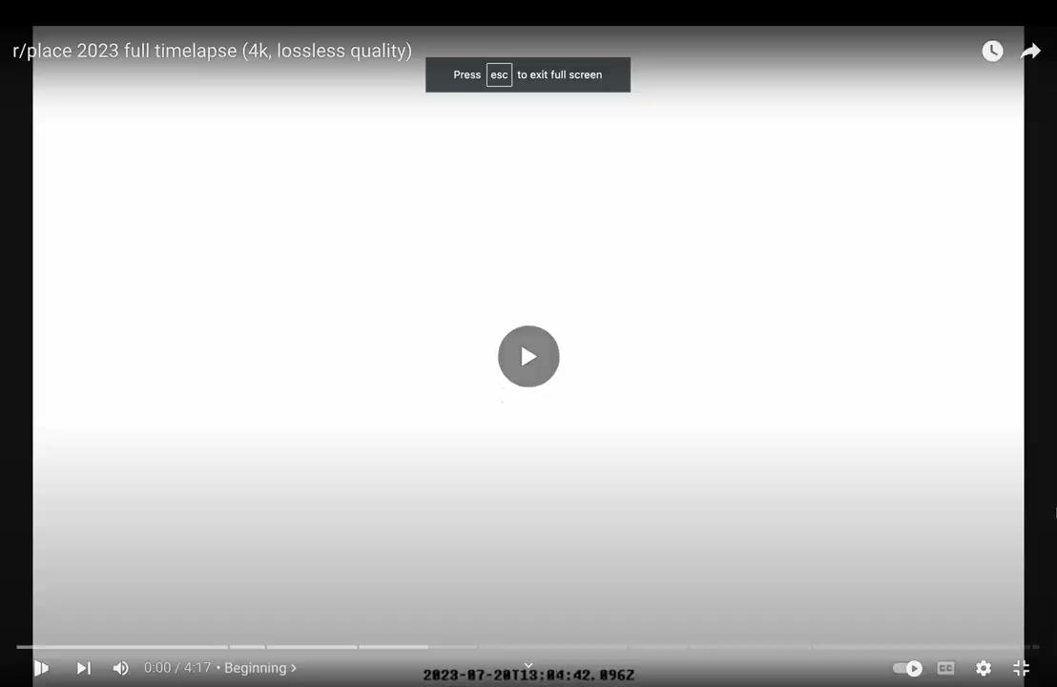
Visualization

Slide 6

The devil is in the detail
S3

Slide 7
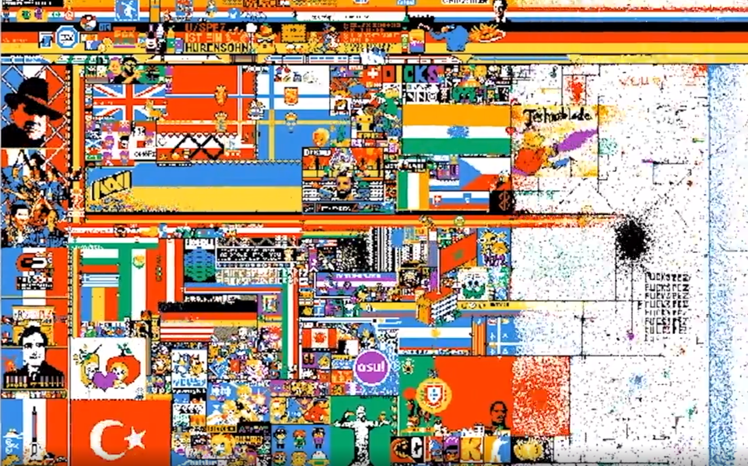
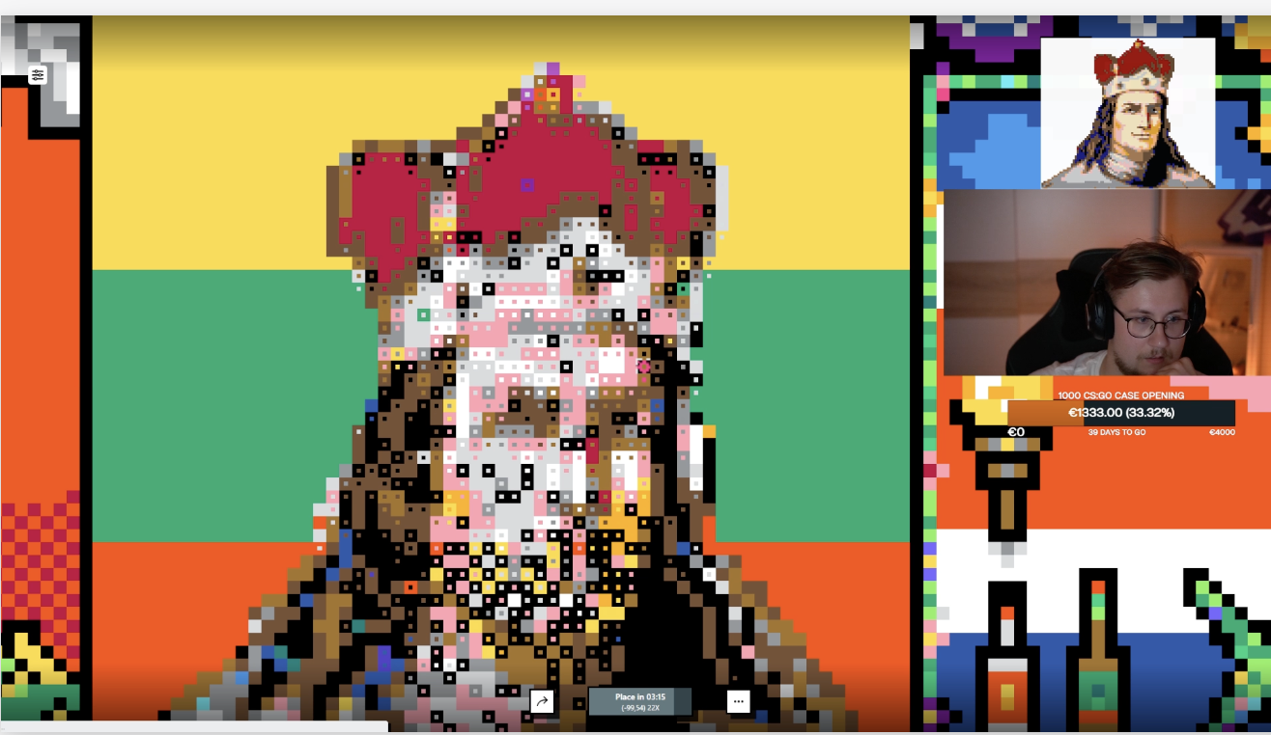
Further Analysis
Moving Color Clusters
Grid Expansion
Identify groups of closely located pixels that are changing to the same color (or group of colors) in an unusually fast time
On times that r/place canvas size increased, what pixels were instantly populated or automated by bots

Slide 8
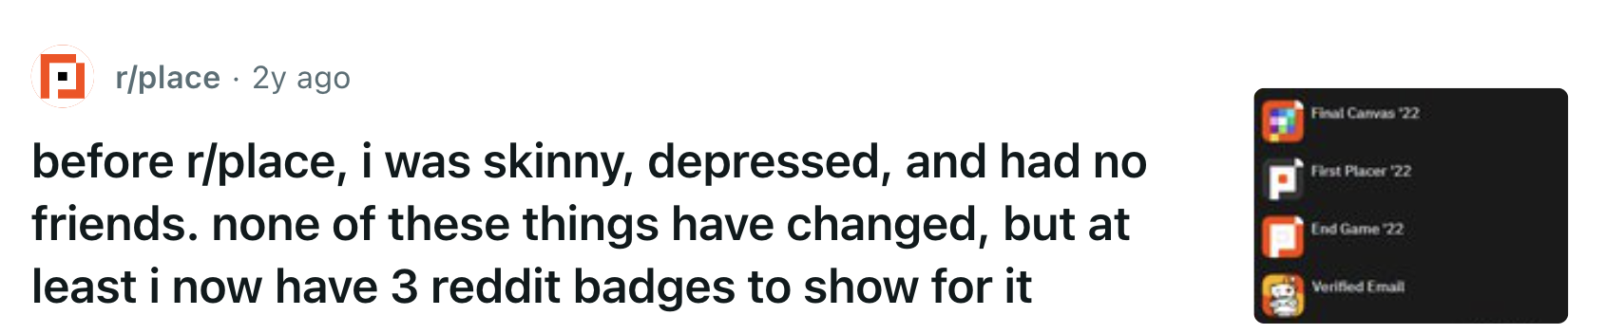
— Thank you
we have expanded our knowledge of the cloud and a mediocre graph to show for it *********

